Slide 1


Project: Java and Web Development (DLBCSPJWD01)
https://github.com/webdeveloperleysan/IuLeysanApp

Slide 2
The purpose of the web application
This is a blogging platform where students exchange information by:
writing articles
editting articles
“favourite” the articles
follow the interesting authors
upload profile picture (added in phase 2)
search article by popular tag (added in phase 2)
page pagination (added in phase 2)
to do all the above, user need to pass authorization (sign in and sign up buttons)

Slide 3
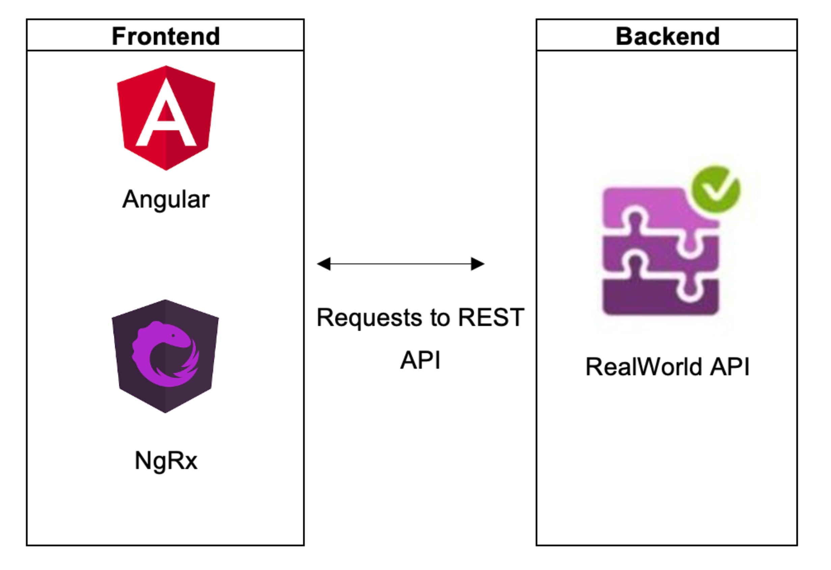
Architecture diagram

Slide 4
Technology
Frontend
HTML | An Angular HTML template renders a view, or user interface, in the browser, just like regular HTML, but with a lot more functionality.
CSS | It is essentially a language that is responsible for describing the appearance of an HTML document. CSS allows to format it and make it more appealing.
Bootstrap | A free HTML/CSS/JavaScript framework for quickly creating an adaptive website design.
Angular CLI | It is the official command-line interface used in the Angular ecosystem. Its purpose is to simplify the creation of high-quality applications.
TypeScript | It is a primary language for Angular development. It is a superset of JavaScript with design-time support for type safety and tooling.
Node.js | In this project I used Node.js to install the Angular CLI on my local system (requirements of Angular). Here Node.js is only frontend, because for the backend I use a public API
NgRx | It is Redux template, it gives features that make debugging easier and simple functions to handle state changes
Backend
RealWorld API | public API, ready-made backend with rest api supporting all necessary functionality

Slide 5
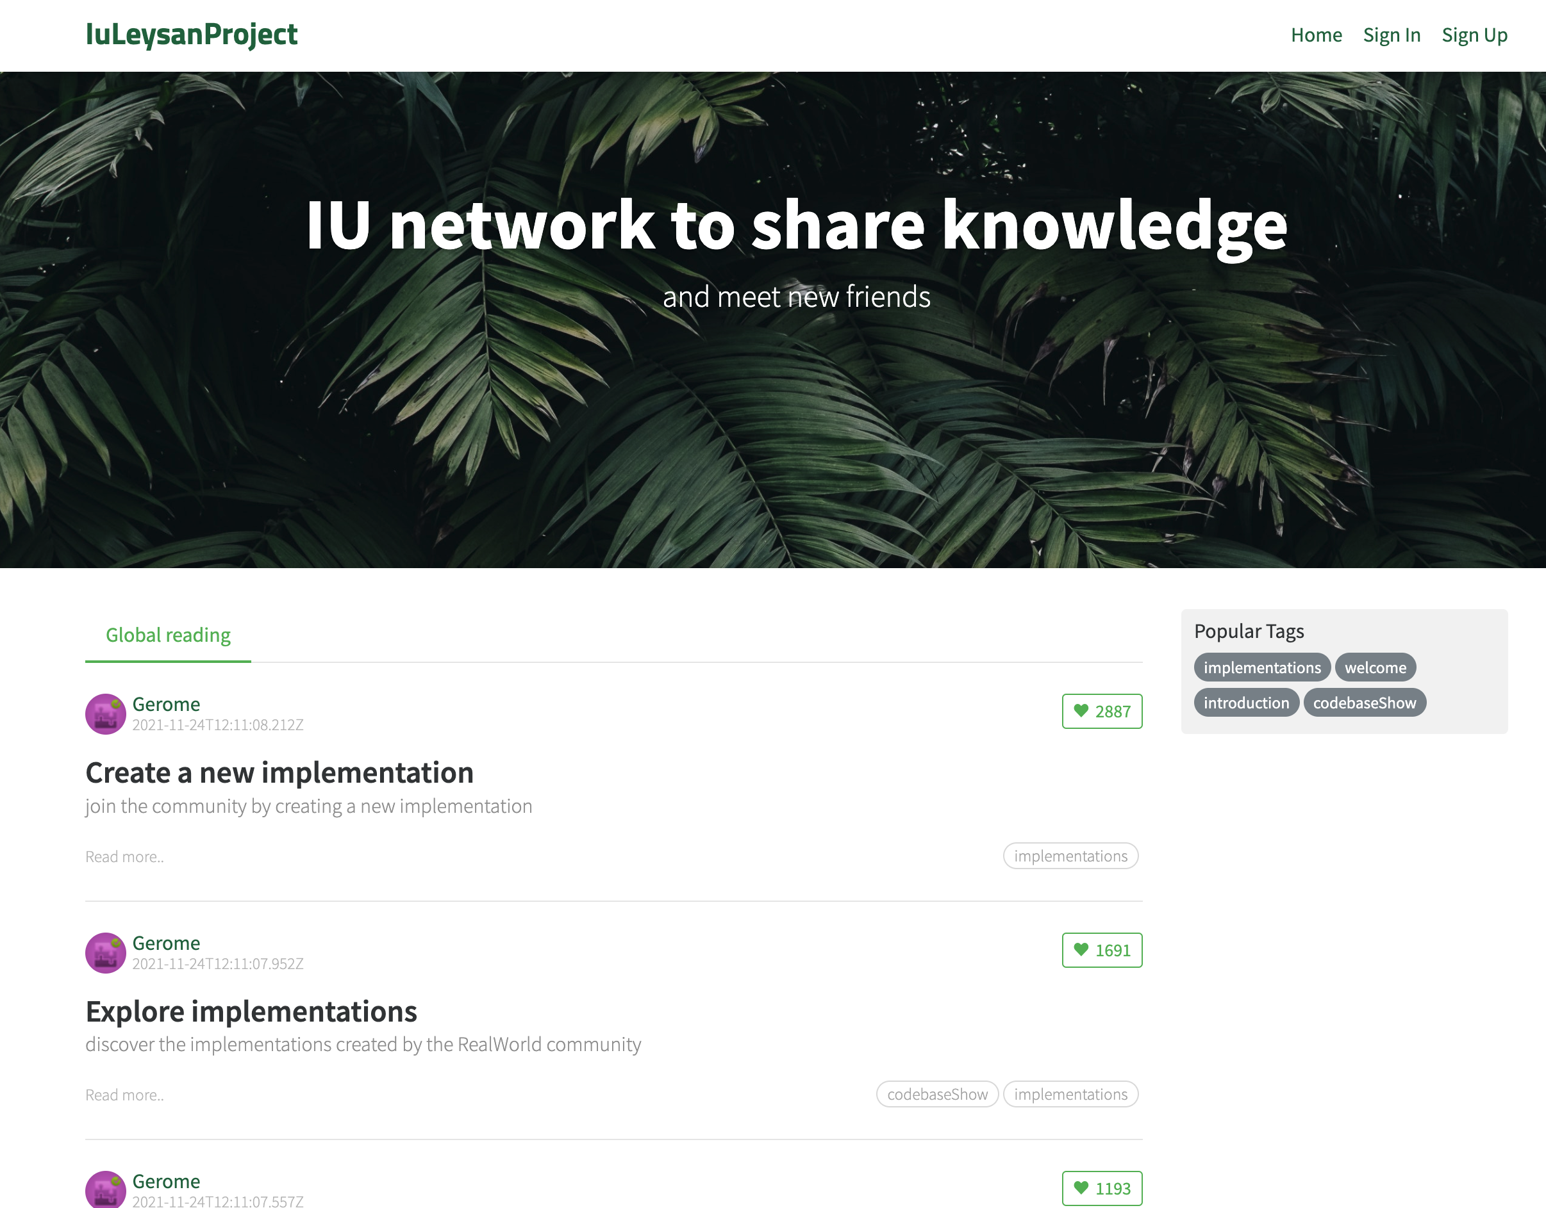
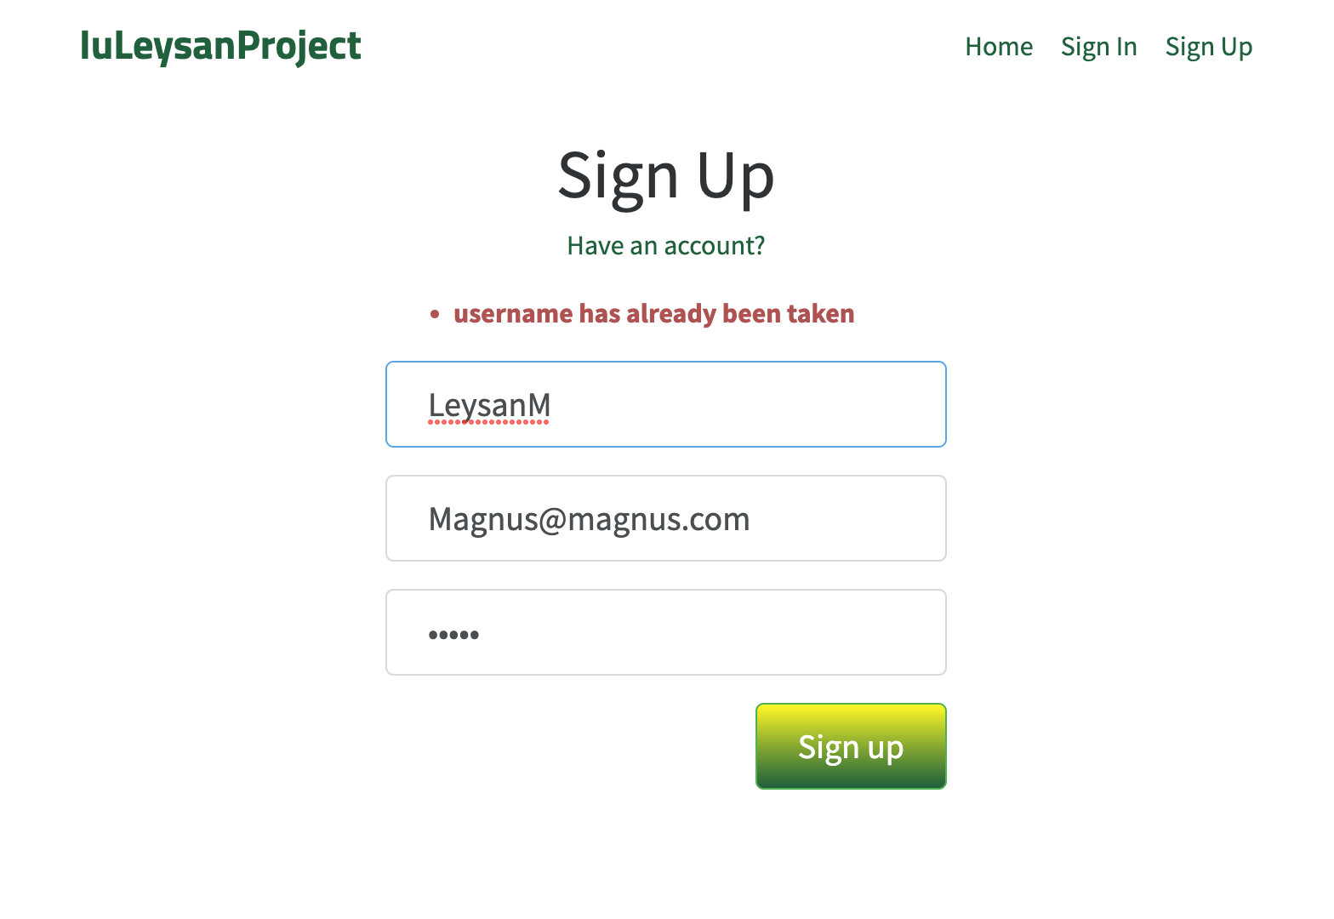
Screenshots of web app with explanations
An unreristered user sees the folowing web application
Backend errors are shown here
Possible to see popular tags and articles

Slide 6
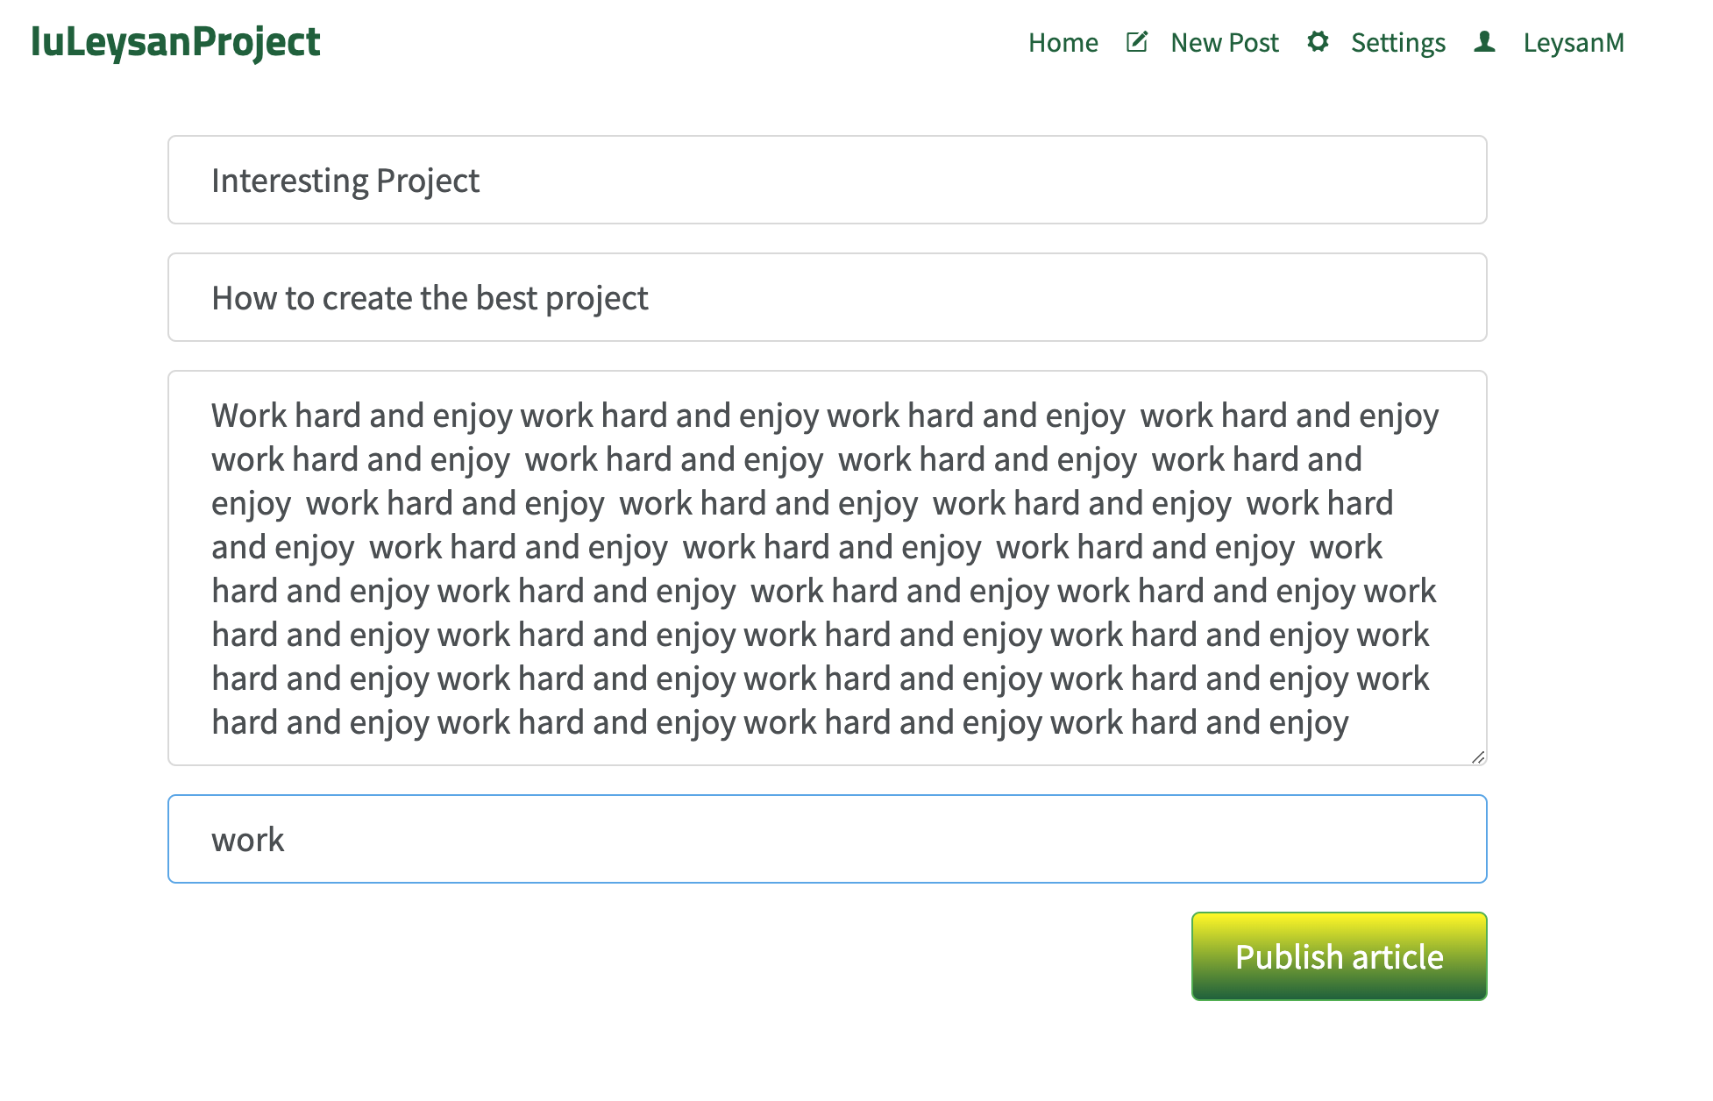
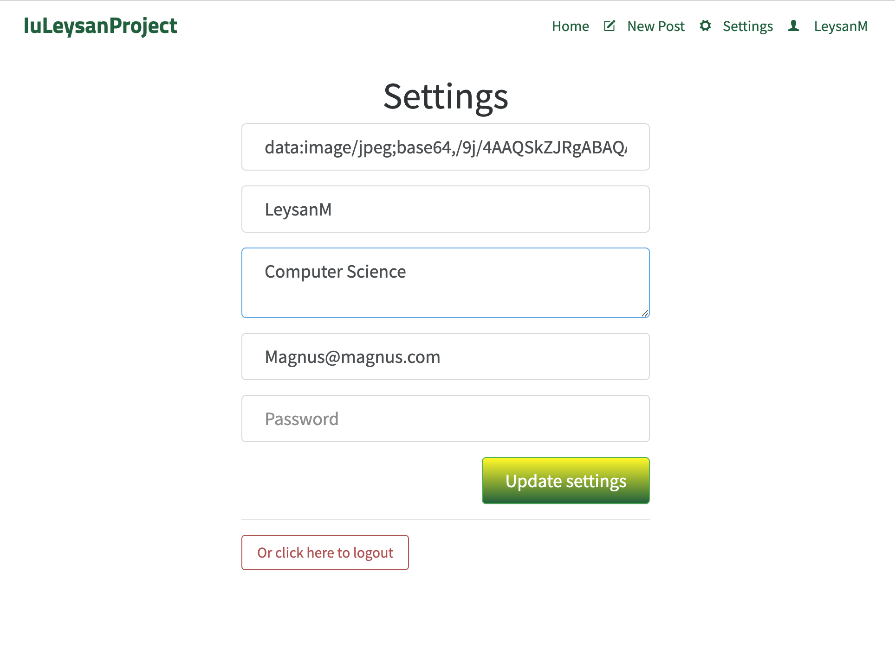
Screenshots of web app with explanations
After successful registration
Page for establishing a new article
Settings page
Add link for a photo
Change/ add username
faculty

Slide 7
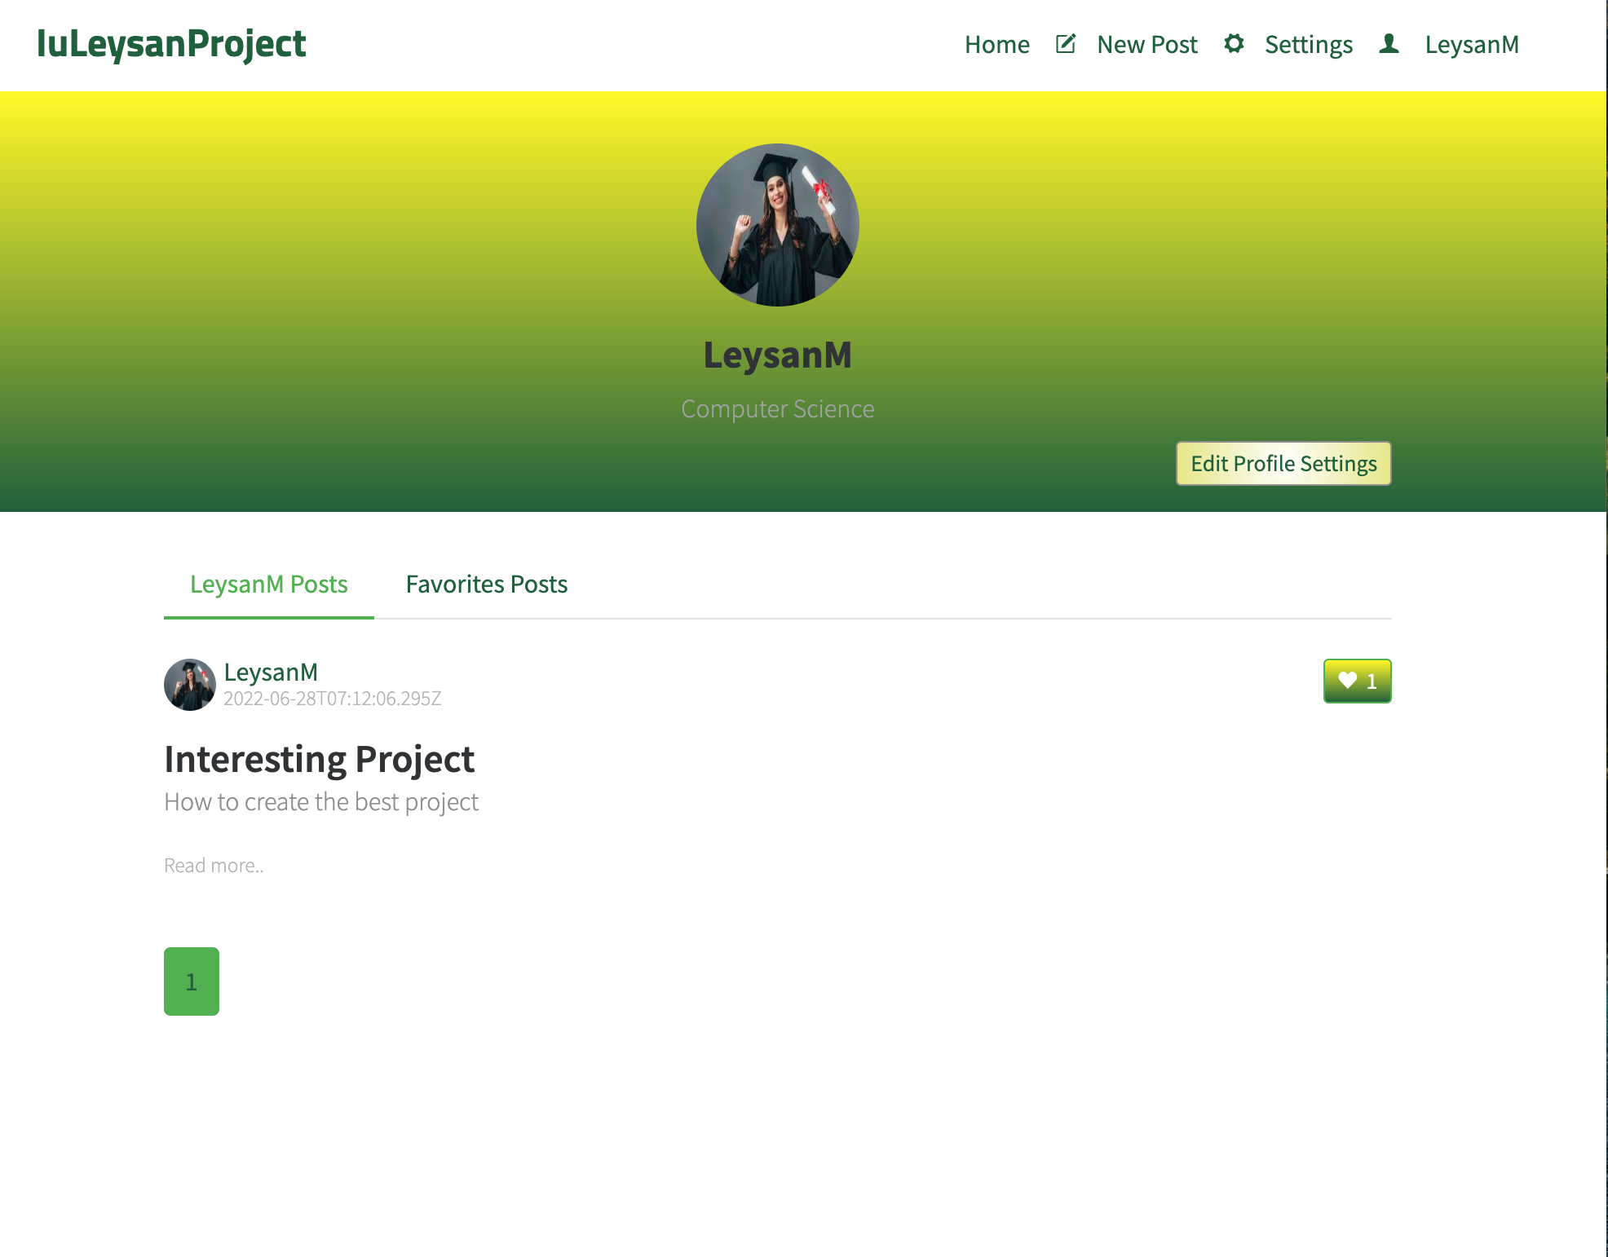
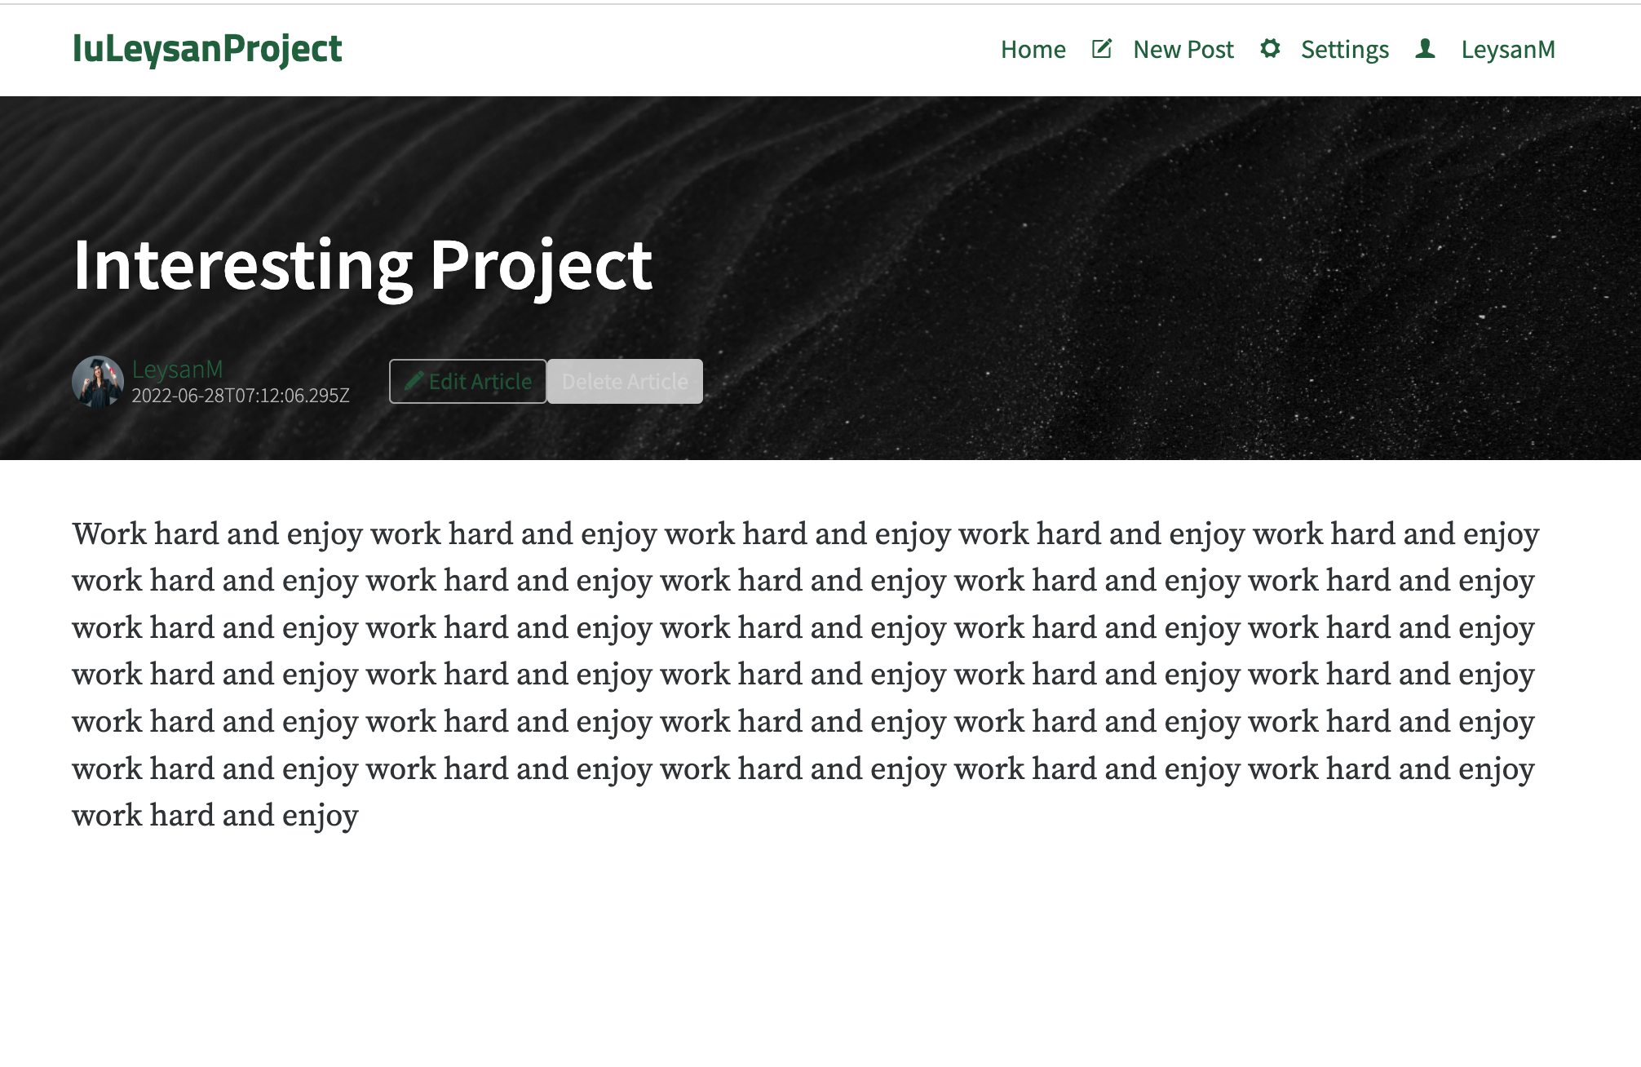
Screenshots of web app with explanations
User page with possibility to edit profile settings:
Article page with possibility to edit and delete article:

Slide 8
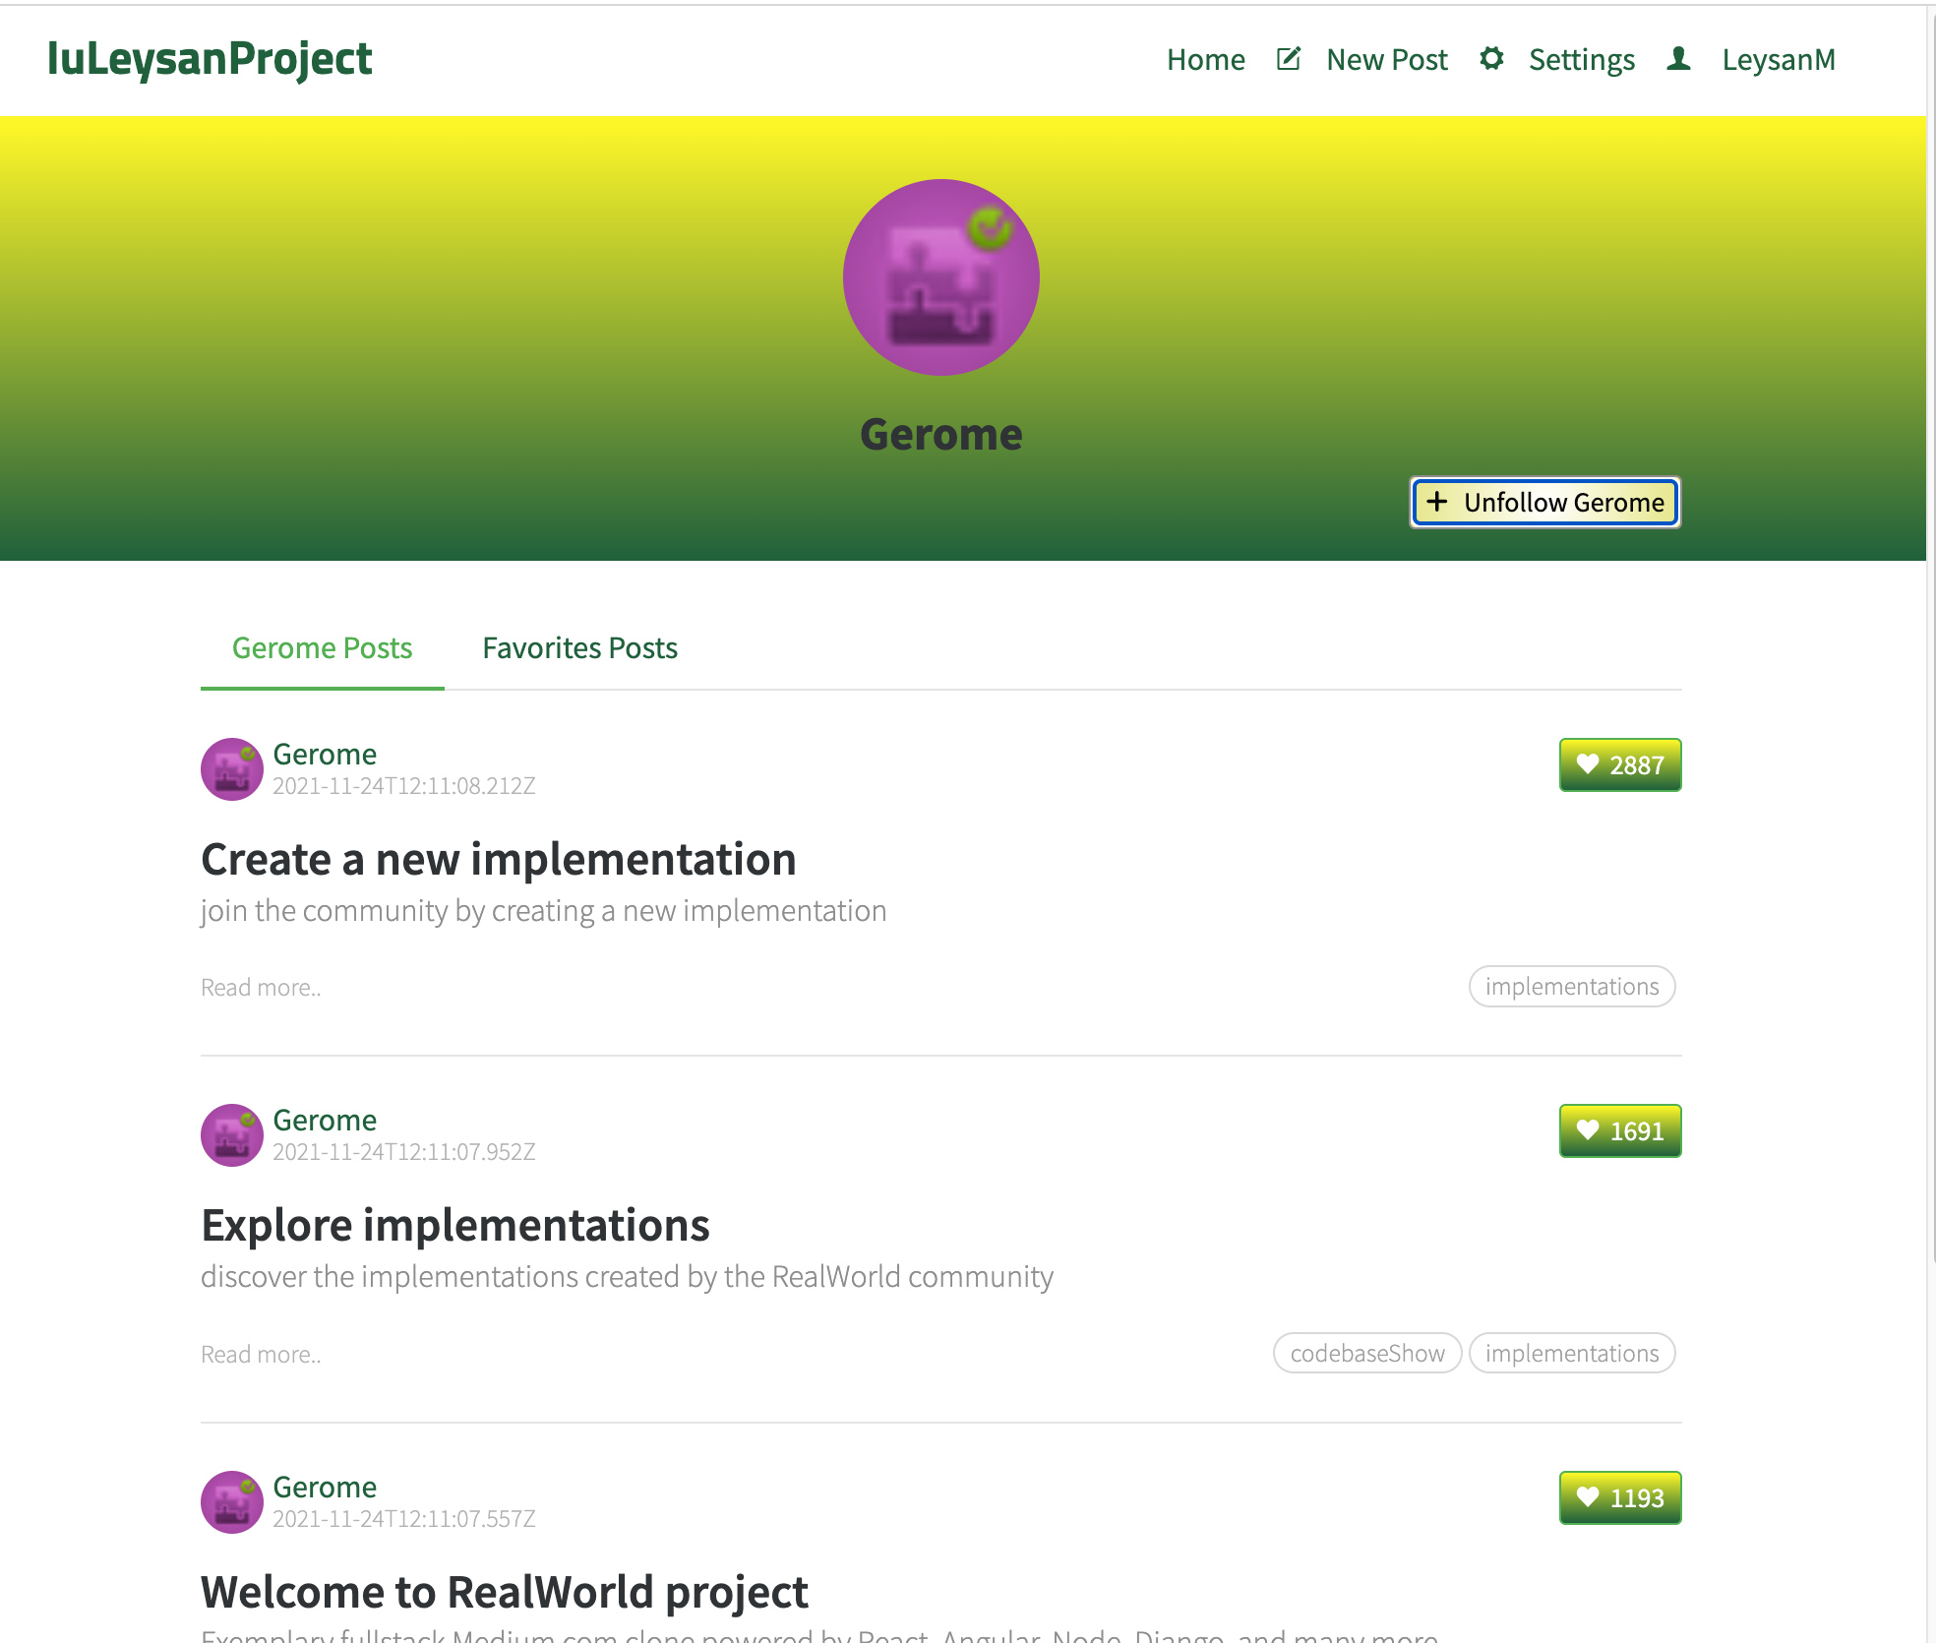
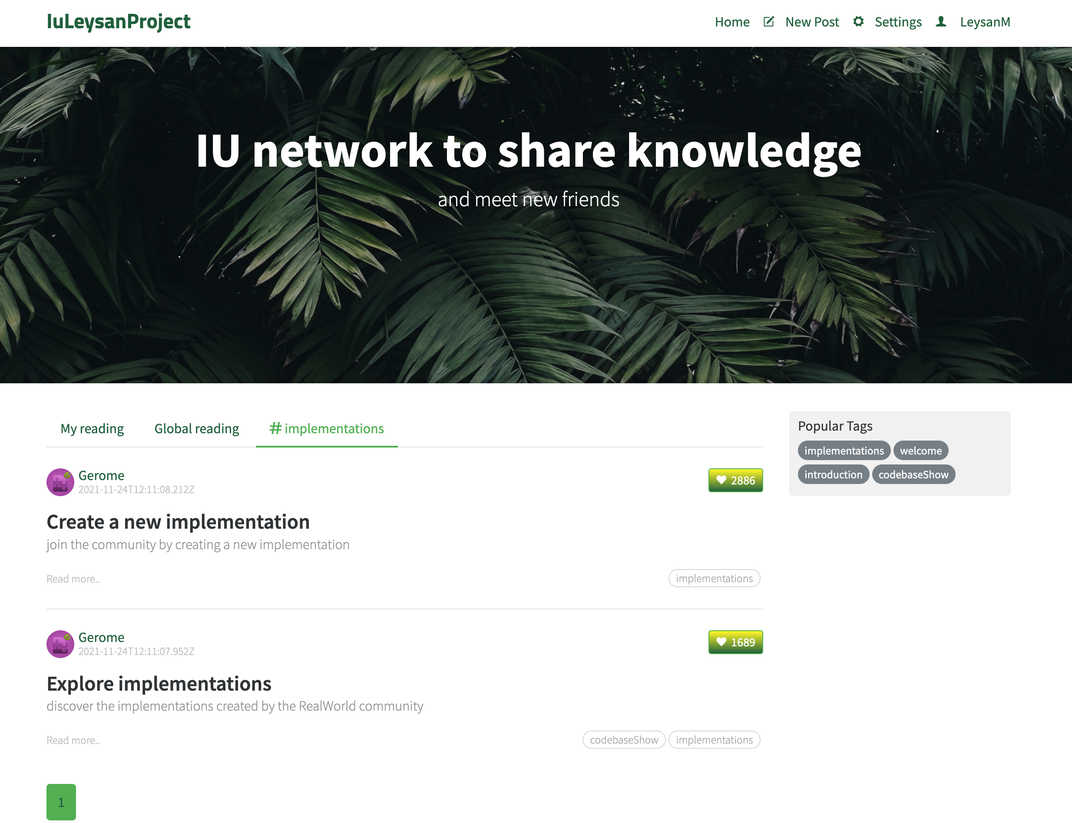
Screenshots of web app with explanations
Page of the other user with possibility to follow him/her and check his/her articles:
Home page after registration
Settings page
Follow/Unfollow button
All posts of the user of interest
Here are followed authors
Popular tag pushed
Pagination

Slide 9
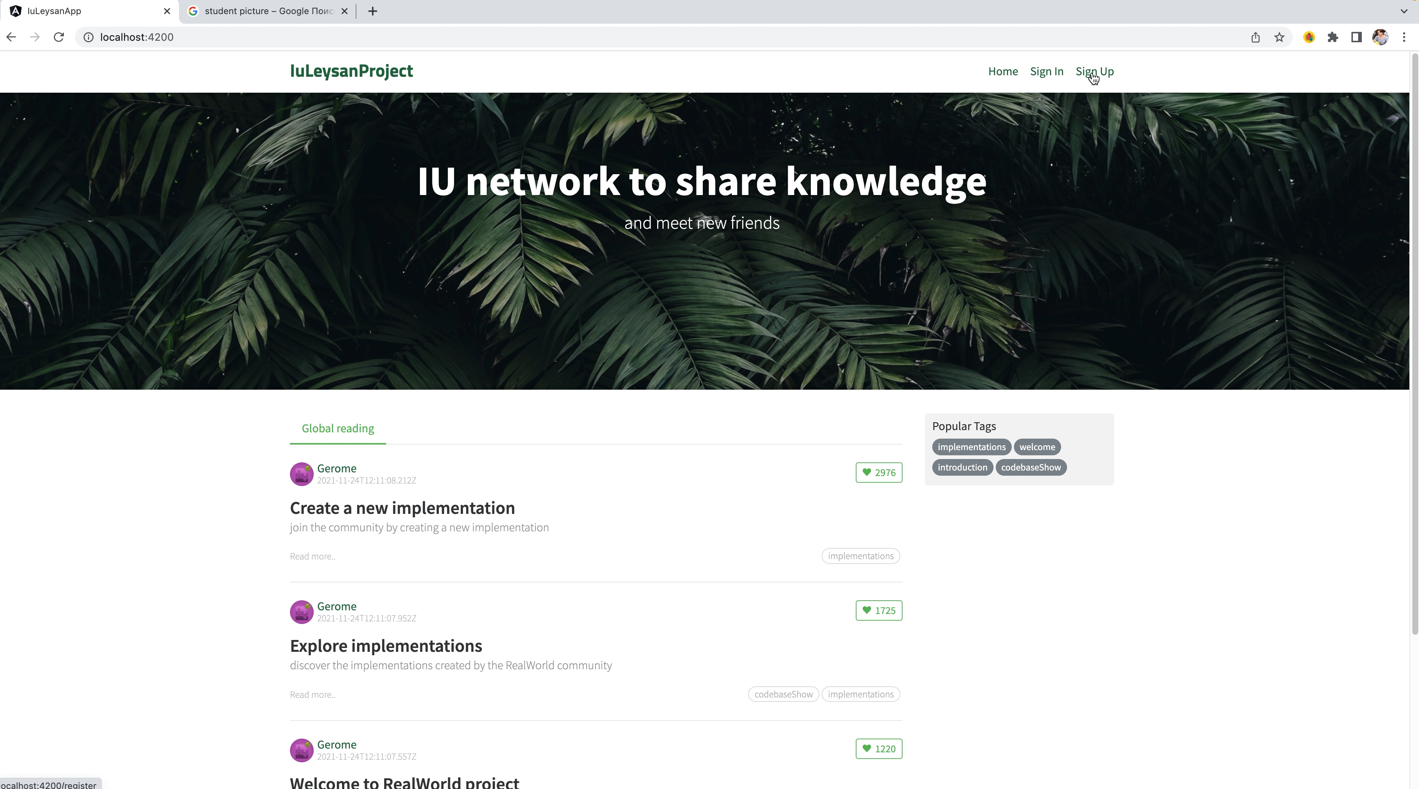
Web application video

